Slide 1











MACHINE LEARNING PROJECT
UNDERSTANDING AND PREDICTING BANK CUSTOMER CHURN
NISHANT GHAWALKAR

Slide 2














WHY?
My motivation:
- Interest in Cognitive Science, Human Behavior and Psychology
Promotional offers:
- Always get offers to join banks in the mail
Curious about why customers leave and if it could be predicted

Slide 3
OBJECTIVE
To understand what factors contributed most to customers leaving the bank.
To create a model that predicts if a customer will leave the bank or not.
To create or improve existing customer retention strategies e.g. incentive offers
THE IMPLEMENTATION OF THIS MODEL WILL ALLOW THE BANK TO MAKE INFORMED DECISIONS REGARDING CUSTOMERS.

Slide 4





1. First approach in solving the problem is obtaining the relevant data.
2. Cleaning the data is the next step. This includes checking for null values, imputing missing values and checking column names.
3. Next, we explore the data to gain insights into our dataset and what it contains. This includes looking for outliers or unusual data
as well as using a correlation matrix to understand the relationship between the response and predictor variables.
ANALYTICAL PIPELINE
4. Modeling using Machine Learning gives us our predictive power on whether the bank will lose a customer or not.
5. Lastly, we interpret the results and see what can we conclude about bank customers leaving the bank. For example, what
feature variable was most indicative of customers leaving the bank?

Slide 5
The bank is at risk of losing billions from customers so it wants to understand why they are leaving and if they can reach them before they exit the bank.
The bank could lose up to $50 billion if the customers decided to take their business to another bank. Some common excuses for leaving are:
Excessive/hidden fees
Bad customer service
Checks/funds bouncing
Most expensive debits charged first
Loyalty means nothing
THE PROBLEM

Slide 6
Retention Plan
The goal is to create a retention plan!
We can help identify who is at risk of leaving the bank and provide outreach to prevent churn.
The model will predict and calculate the likelihood of each customer exiting the bank.
SOLUTION

Slide 7
RowNumber: Row Number
CustomerId: Customer ID
Surname: Customer’s Surname
CreditScore: Customer’s Credit Score
Geography: Country of Customer
Gender: Customer’s Gender
Age: Customer’s Age
Tenure: Customer’s Tenure
Balance: Customer’s Balance
NumOfProducts: How many accounts, bank account affiliated products the person has?
HasCrCardDoes: Does the customer have a credit card through the bank?
IsActiveMember: Subjective, but for the concept
EstimatedSalary: Customer’s Estimated Salary?
Exited: Did they leave the bank after all?
THE DATASET

Slide 8










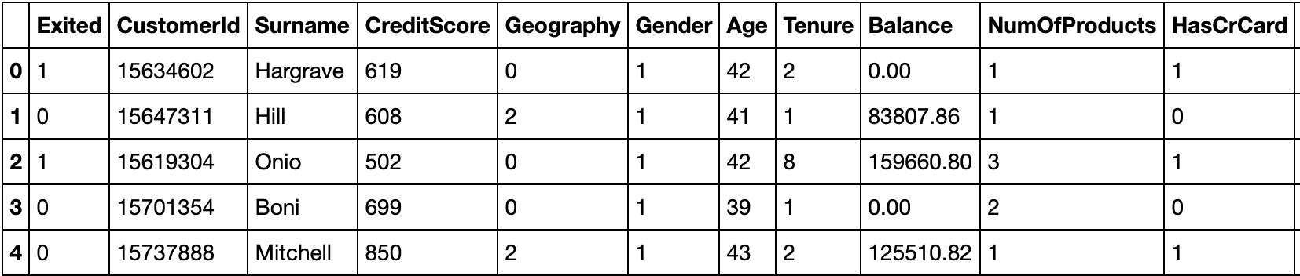
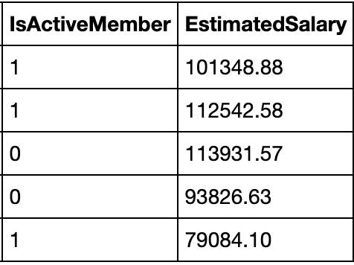







THE TABLE

Slide 9




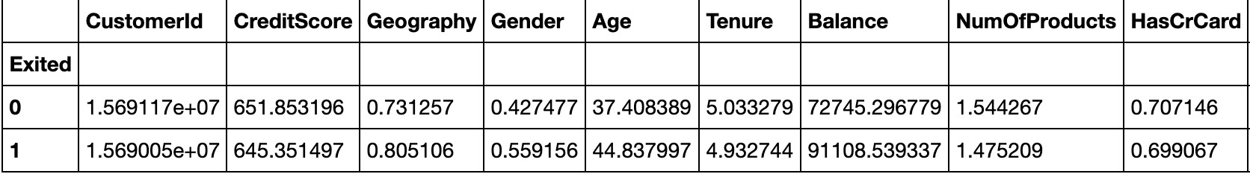
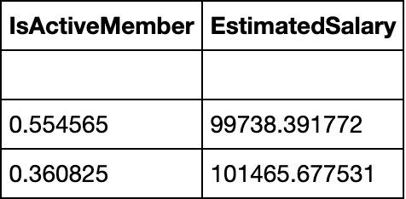





SUMMARY – EXITED VS NOT EXITED
Dataset has 10,000 entries
Class Imbalance Problem (Exited vs Non Exited)
The bank had an exit rate of 20.4%
The mean credit score of customers was 650.52
0 = France, 1 = Germany and 2 = Spain
0 = Male and 1 = Female

Slide 10
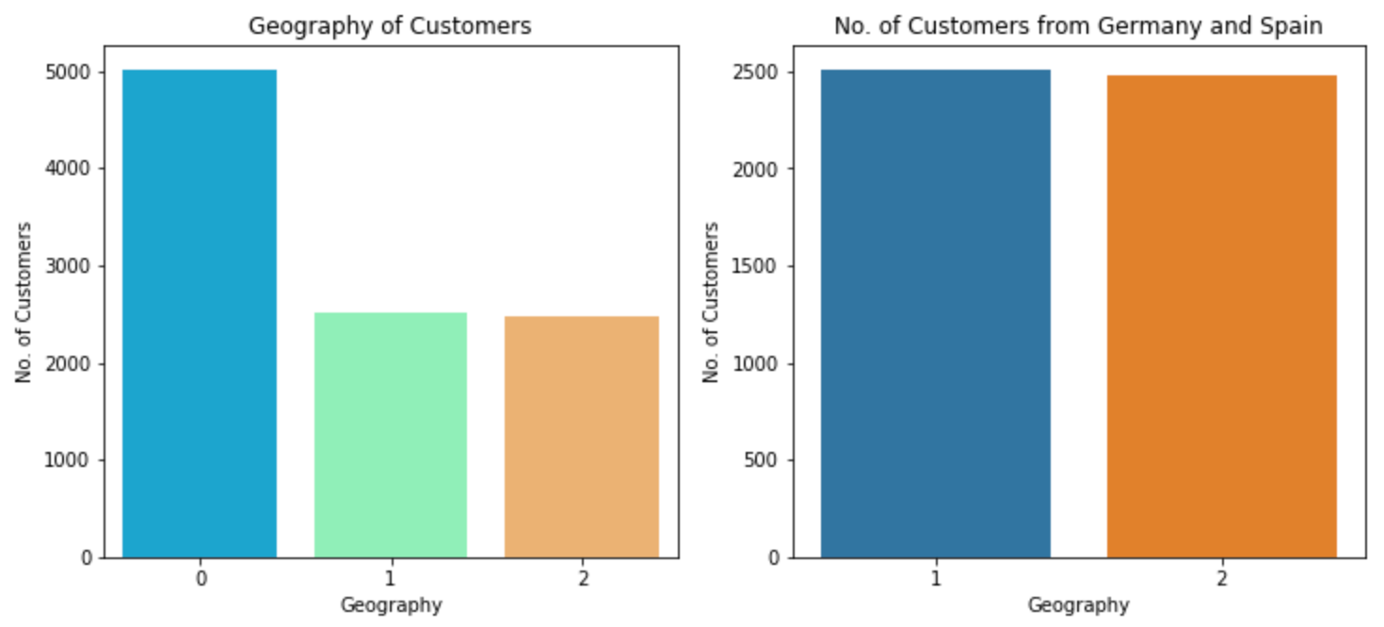
CUSTOMER BREAKDOWN - GEOGRAPHY
0 = France, 1 = Germany and 2 = Spain
There were twice as many customers from France than from Spain or Germany.

Slide 11
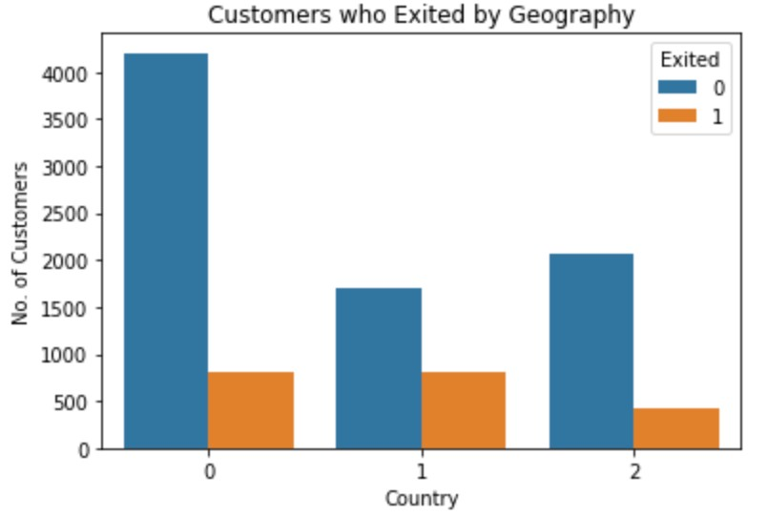
CUSTOMERS WHO EXITED - GEOGRAPHY
0 = France, 1 = Germany and 2 = Spain
We can see Germany had the most customers who exited followed by France and Spain.

Slide 12
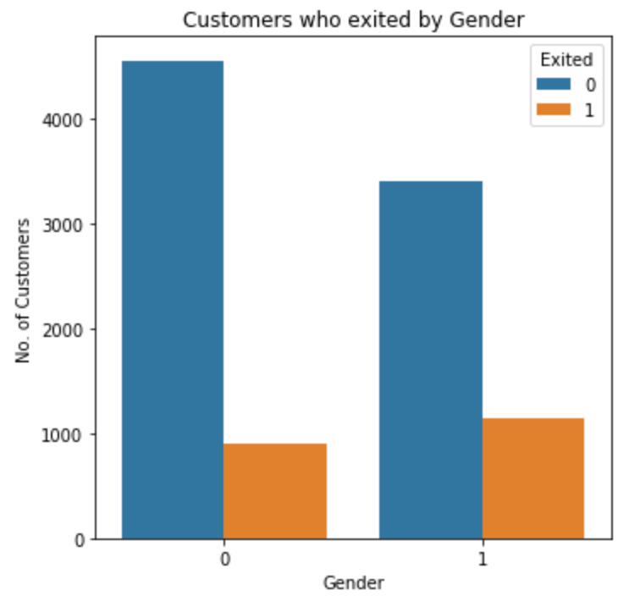
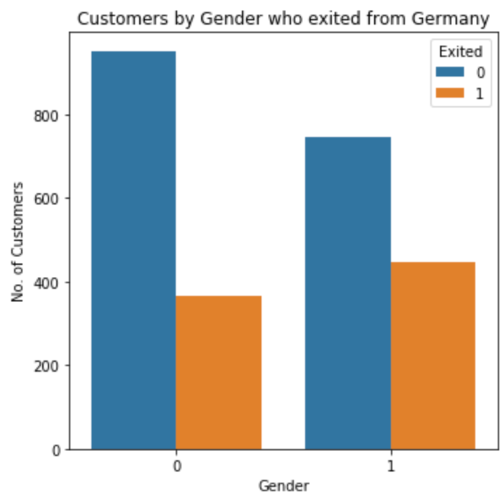
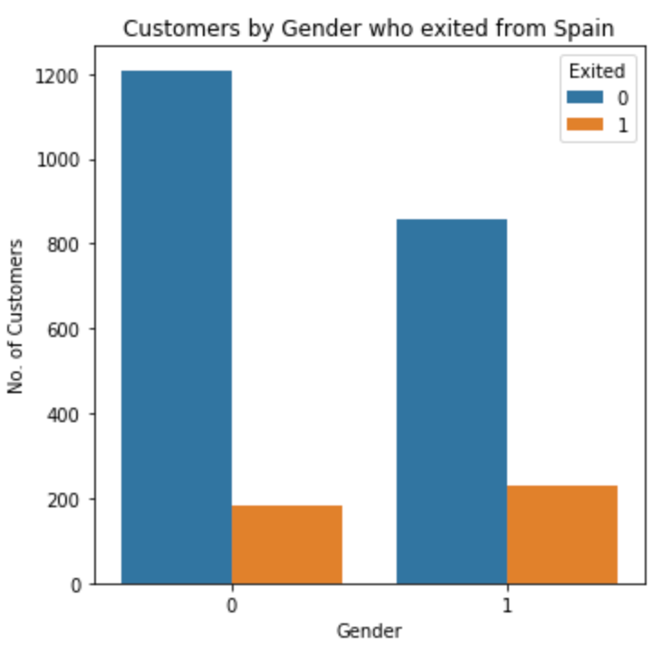
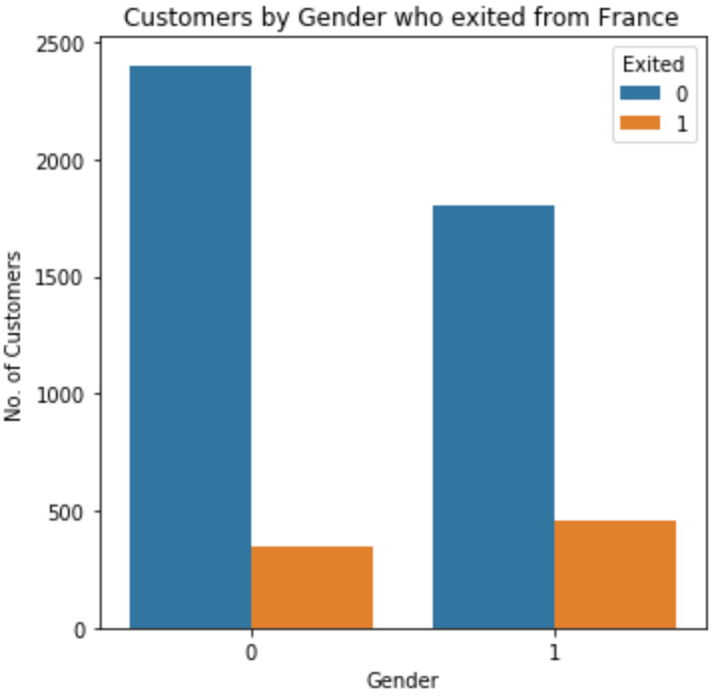
CUSTOMERS WHO EXITED – GENDER & GEOGRAPHY
The first plot shows the breakdown of customers who exited by their gender and the rest of the plots look at customers by gender who exited from France, Germany and Spain.
From these plots, we can see that there were a higher number of female customers who exited, France had the highest number of female customers who exited the bank and Germany had the highest number of Male customers who exited the bank.

Slide 13
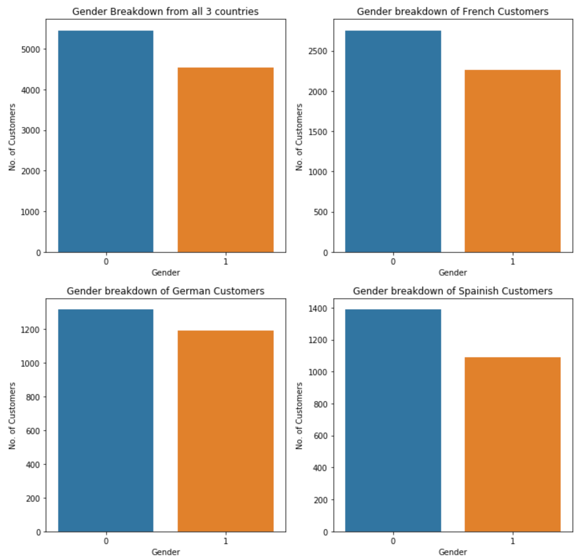
CUSTOMERS BY GENDER AND COUNTRY
The plots look at the gender breakdown of all customers and customers from each country. We can see that France has the highest female and male customers

Slide 14
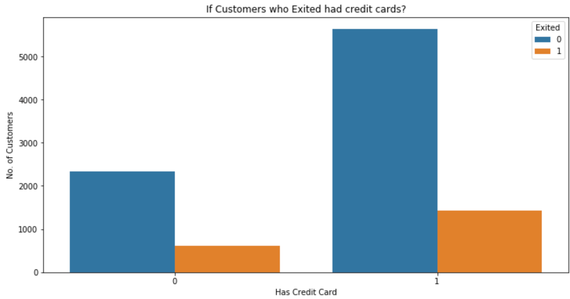








CUSTOMERS EXITED – CREDIT CARD
The plot shows whether customers had a credit card and if they exited. Customers who had a credit card exited more than customers who did not possess a credit card

Slide 15
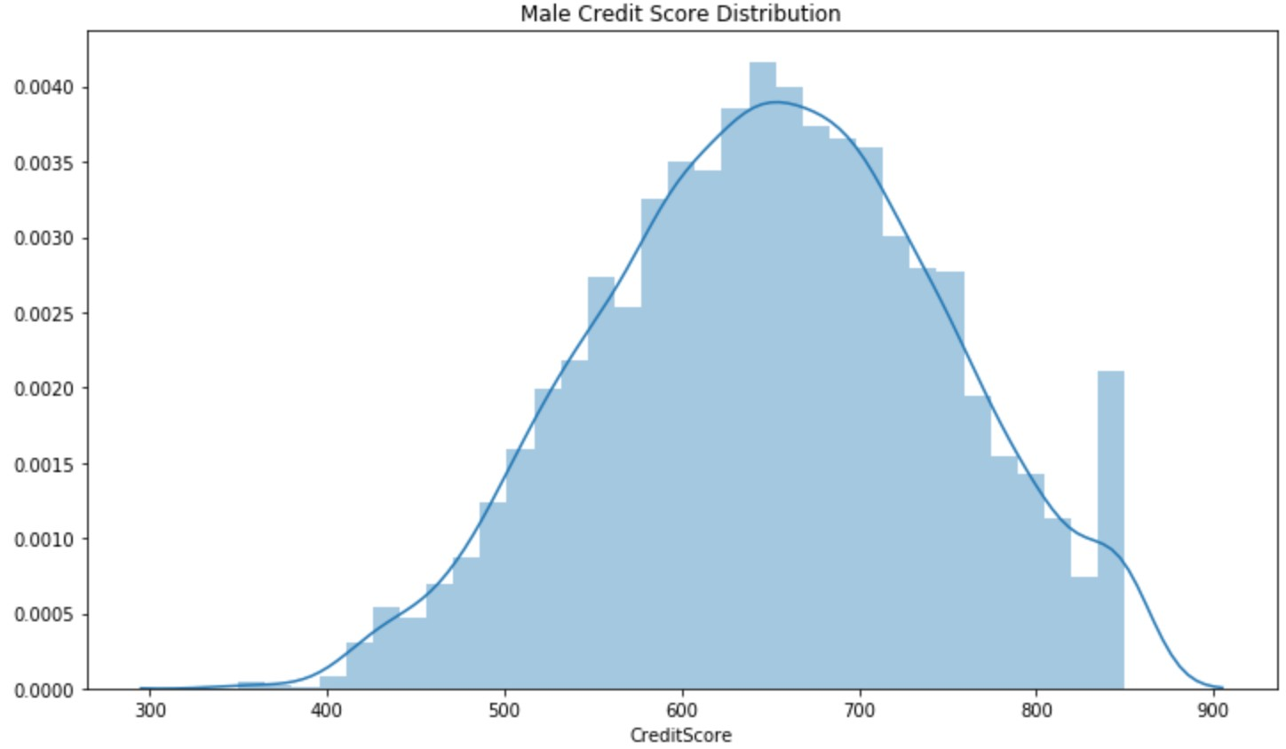
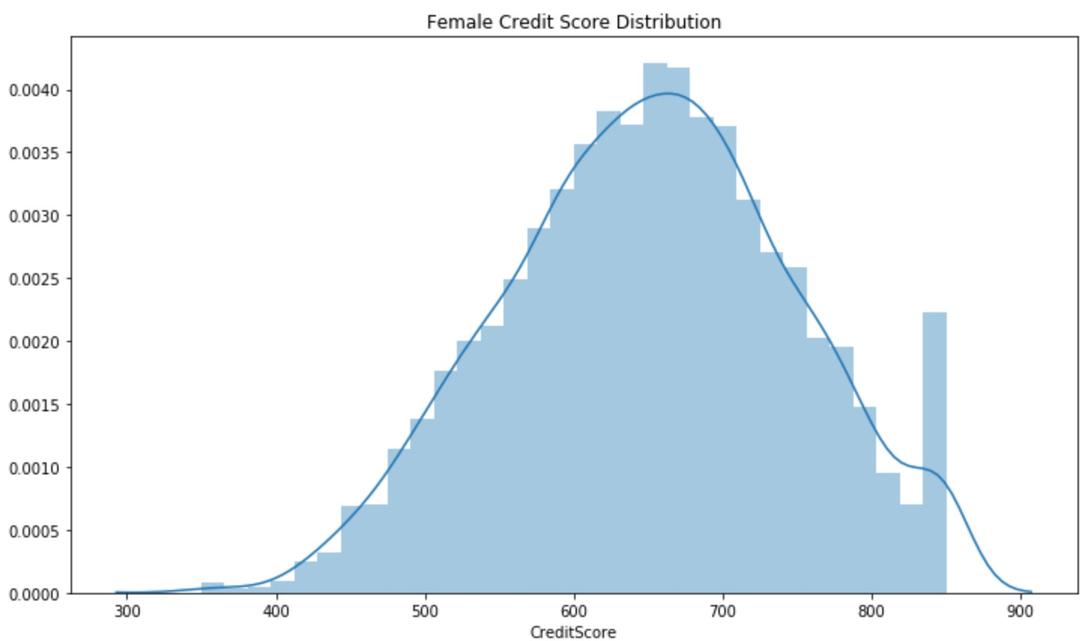
CREDIT SCORE DISTRIBUTION – BY GENDER
The plots above look at the credit score distribution of female and male customers. There is no significant difference in the distribution of both gender's credit scores

Slide 16
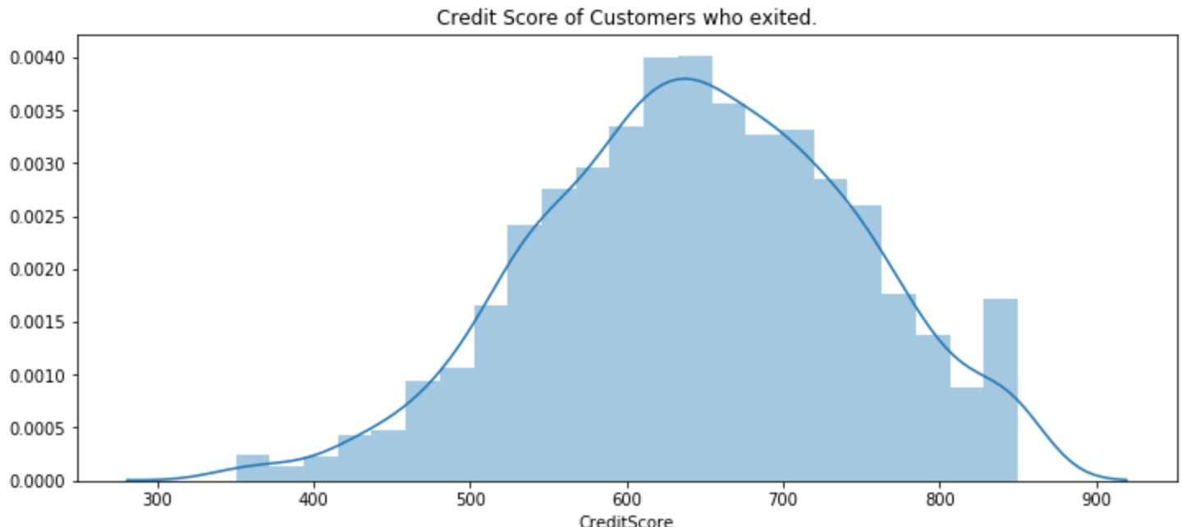
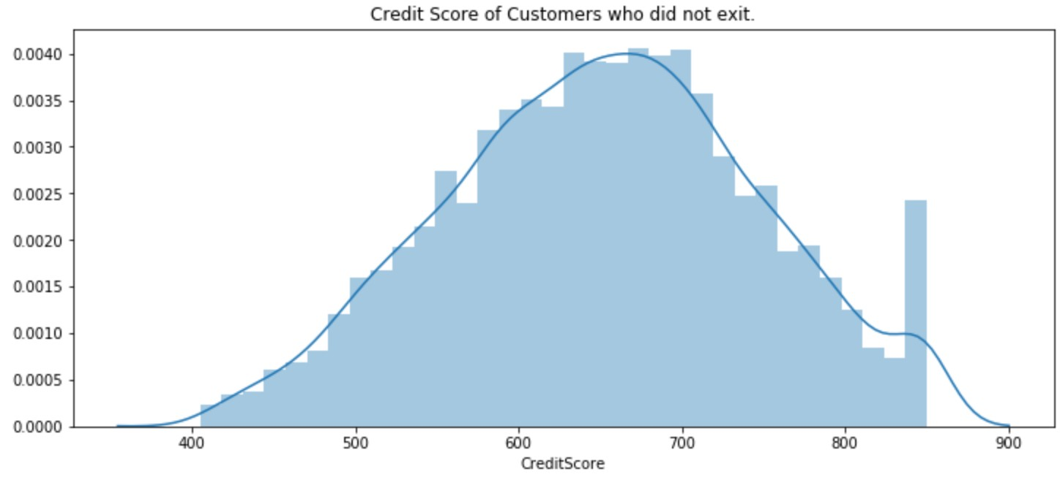
CREDIT SCORE DISTRIBUTION – EXITED VS NOT EXITED
The plots above show the credit score distribution of customers who exited and did not exit. Customers who exited had a roughly lower average credit score.

Slide 17
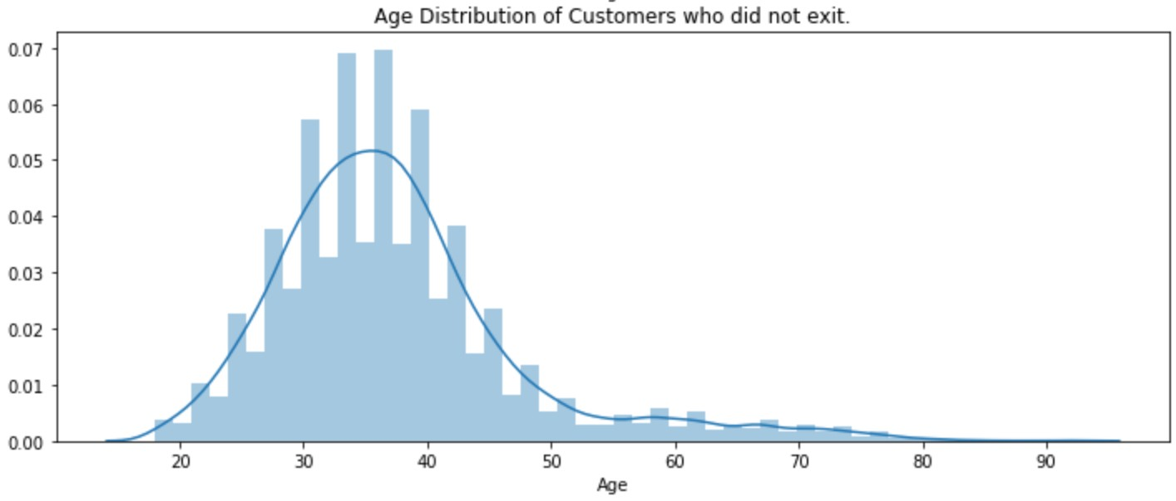
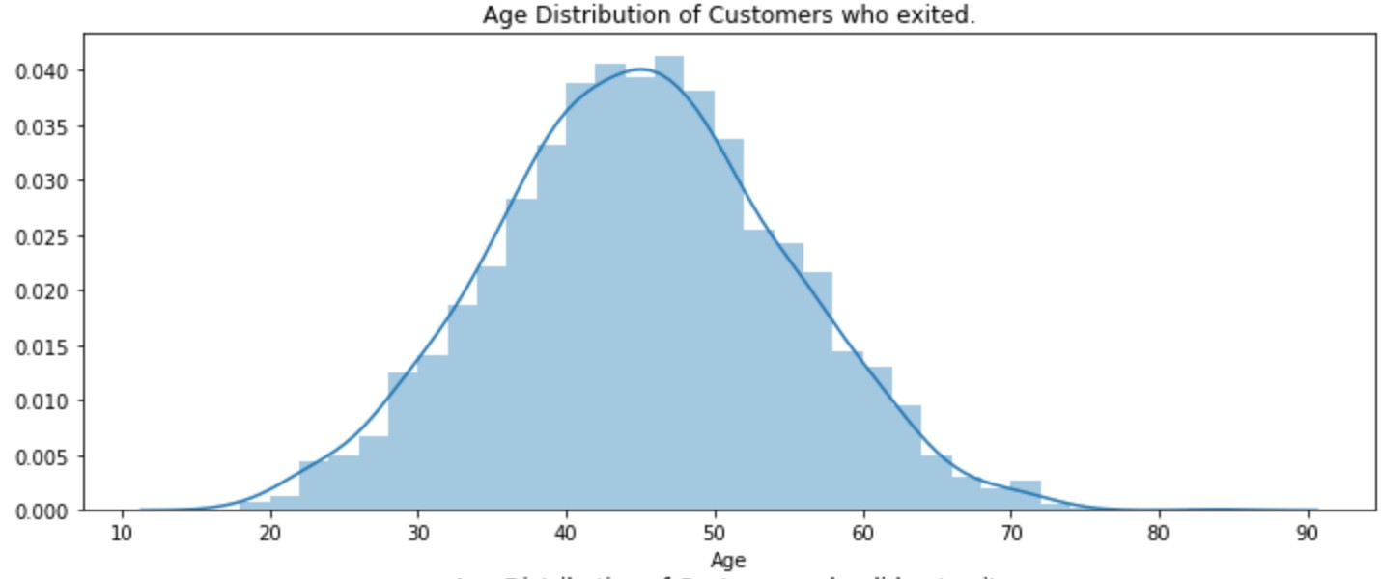
AGE DISTRIBUTION – EXITED VS NOT EXITED
The plots below show the age distribution of customers who exited and who did not exit. The age distribution of customers who exited looks close to normally distributed while the age distribution of customers who did not exit is positively skewed.

Slide 18
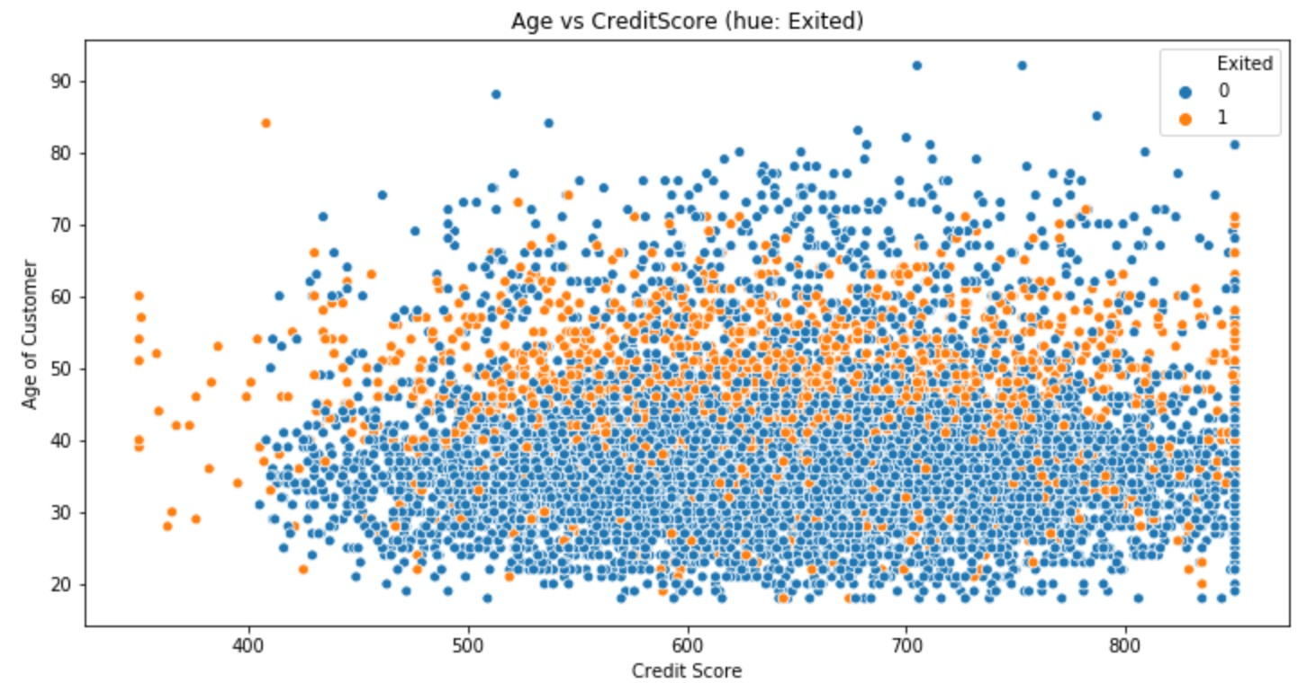
SCATTER PLOT – AGE VS CREDIT SCORE (HUE: EXITED)
The plot below is a scatterplot of Credit Score and Age with the points color coded by whether customers exited or not. It can be seen that the majority of the people who exited were between 40 and 60 years old

Slide 19
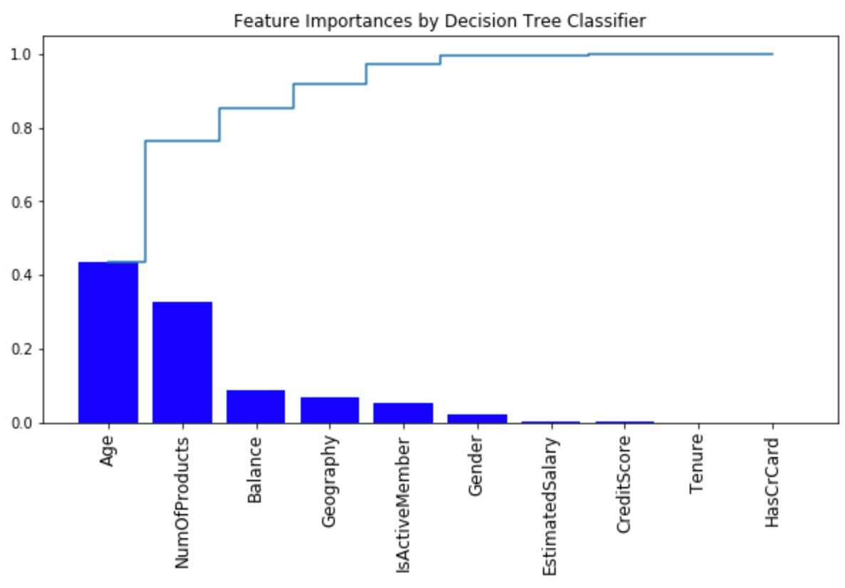
DECISION TREE – FEATURE IMPORTANCE
Top 3 Features:
Age
Number of Products
Balance

Slide 20
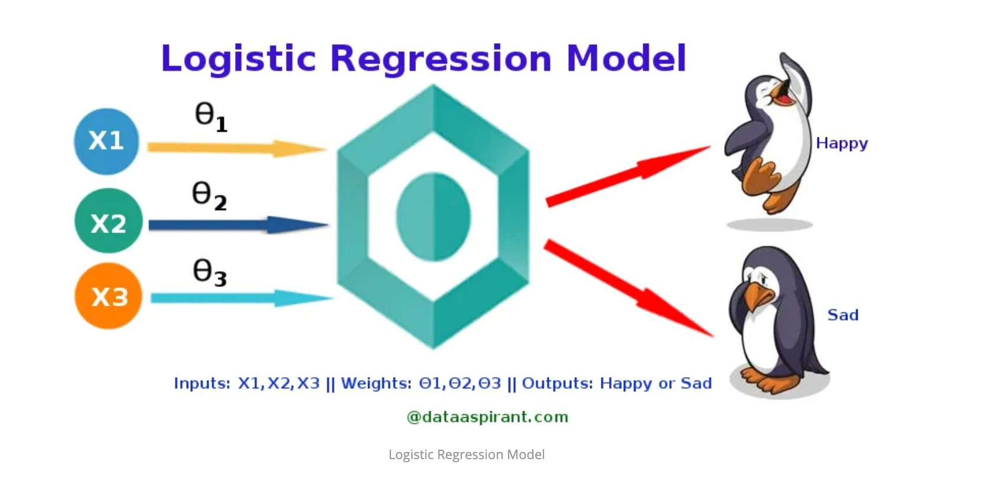
INTRODUCTION TO LOGISTIC REGRESSION – BASE RATE MODEL
The Logistic Regression Classifier was chosen as the base rate model. A base rate model is used to compare how other models perform against it.

Slide 21
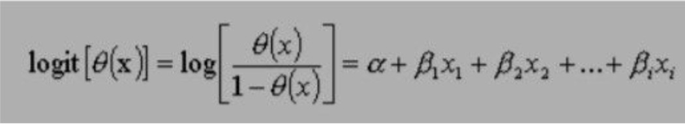
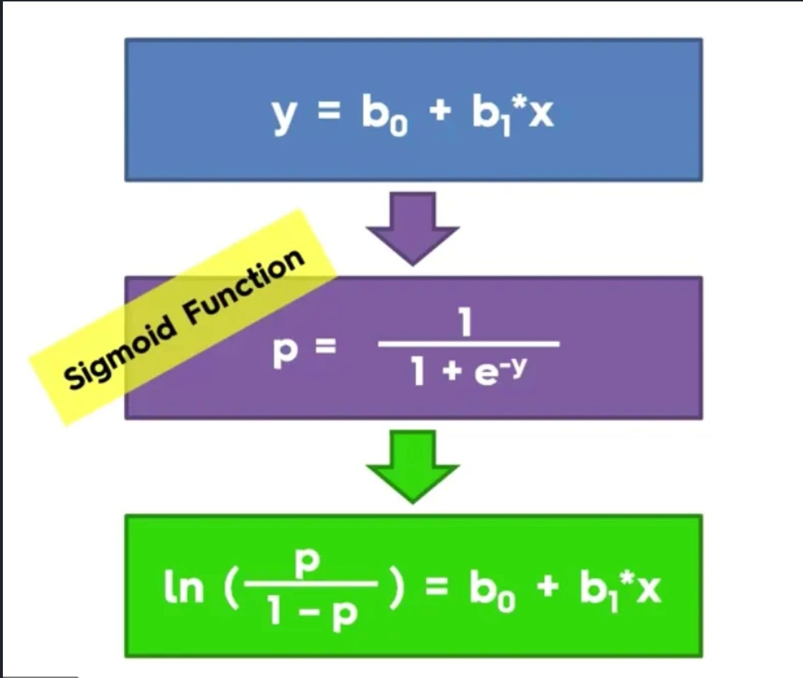
LOGISTIC REGRESSION – HOW IT WORKS
Θ(x) – Dependent Variable (in our analysis, ‘Exited’)
(xi) – Independent Variable (the variable that predicts the event)
⍺ - Constant
Β – coefficient of predictor variable
Logit function (aka sigmoid function)

Slide 22
CLASS IMBALANCE – EVALUATION METRIC
This dataset is an example of a class imbalance problem because of the uneven distribution of customers who did and did not exit the bank. To handle this, use the SMOTEENN method which combines over- and under-sampling using SMOTE and Edited Nearest Neighbors
In this case, evaluating our model’s algorithm based on accuracy is the wrong thing to measure. We will have to take into consideration the False Positive and False Negative Errors and use that as a metric to evaluate our model's performance.
False Positives (Type I Error): You predict that the customers will leave, but do not.
False Negatives (Type II Error): You predict that the customer will not leave, but does leave.
Which error should we be more concerned about?

Slide 23
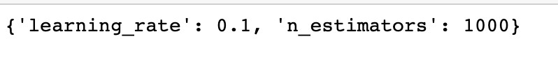
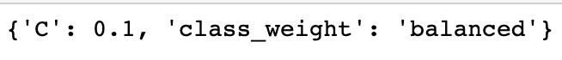
HYPERPARAMETER TUNING
AdaBoost Classifier :
SVM :
Decision Tree :
Random Forest:

Slide 24





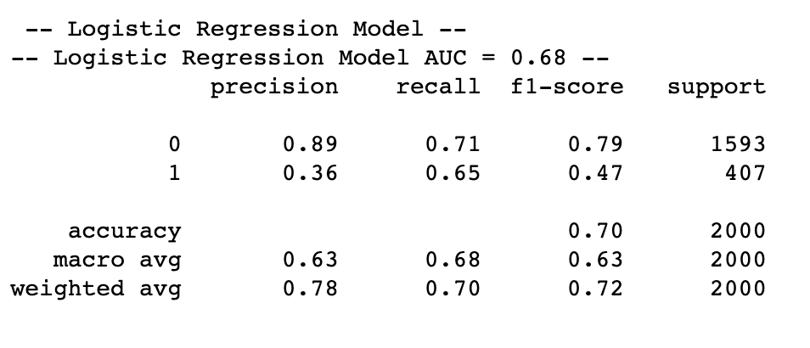
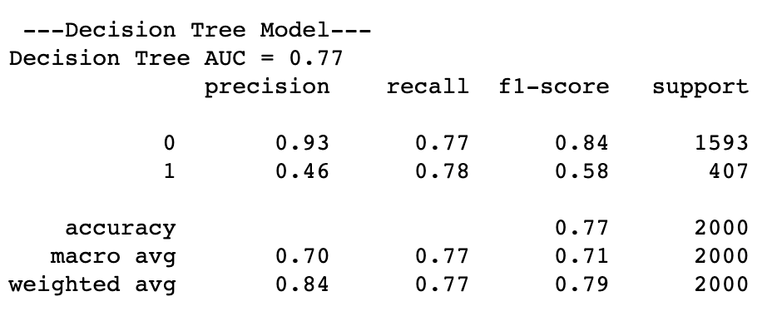







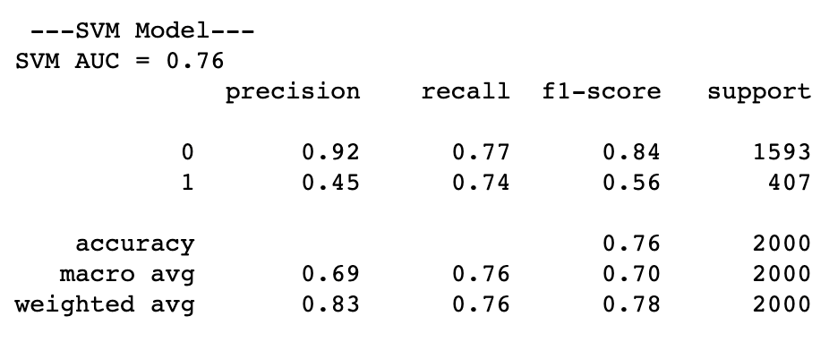
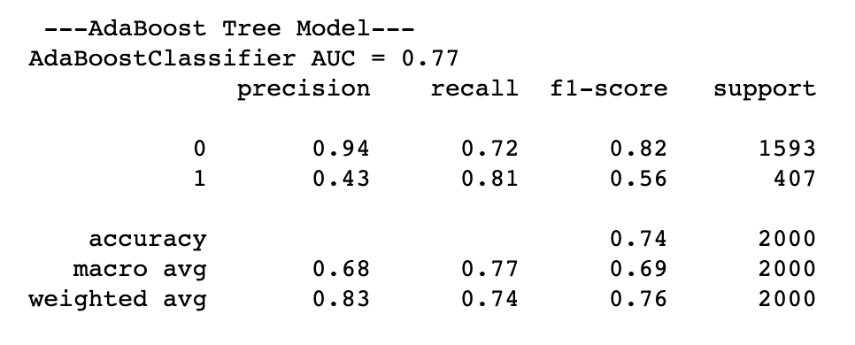



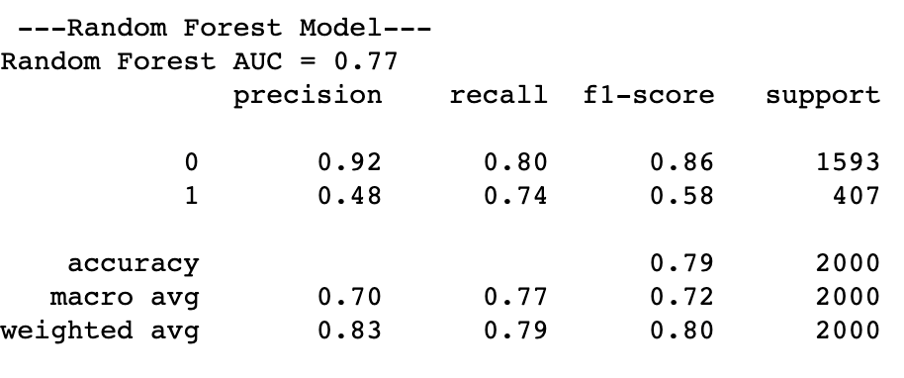
ALL MODEL EVALUATIONS – CLASSIFICATION REPORT

Slide 25
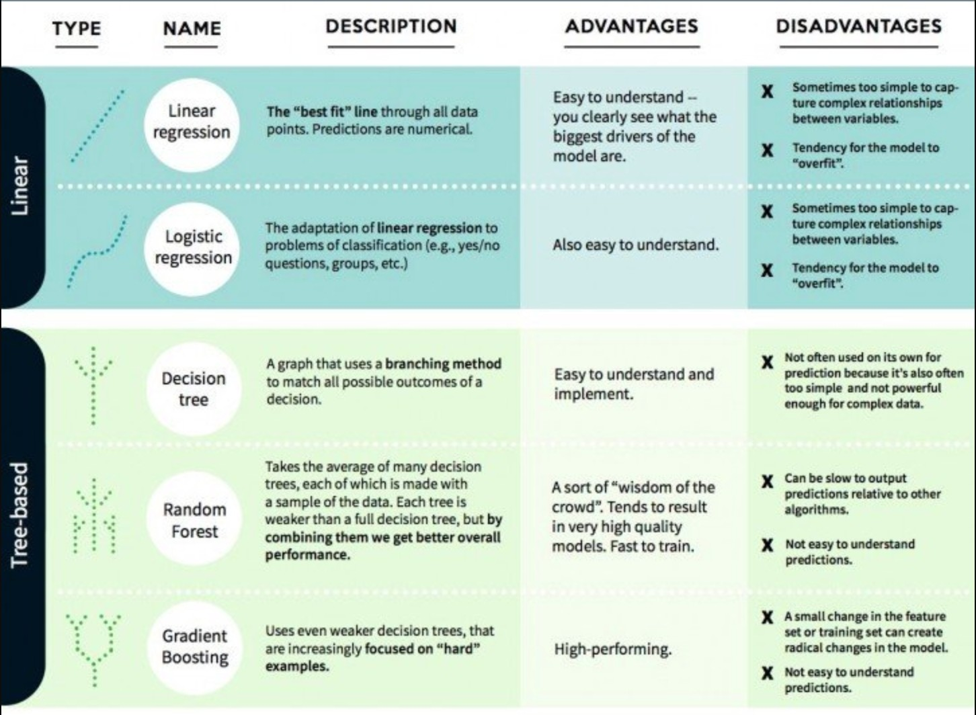
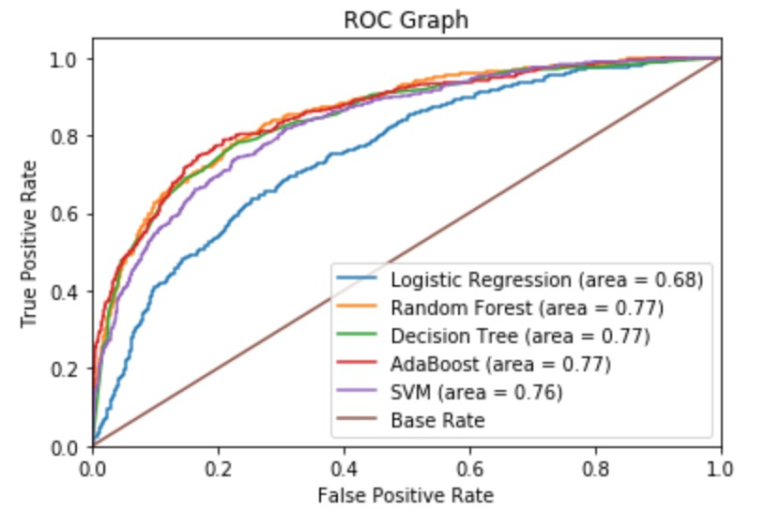
MODEL COMPARISON
The ROC graph allows you to classify your errors for your true labels and false labels.

Slide 26
SUMMARY
Germany had the most customers who exited followed by France and Spain
There were a higher number of female customers who exited. France had the highest number of female customers who exited and Germany had the highest number of male customers who exited the bank.
France had the highest female and male customers
There is no significant difference in the distribution of both gender's credit scores
Customers who exited had a roughly lower average credit score.
Customers who had a credit card exited more than customers who did not possess a credit card.
The majority of the people who exited were between 40 and 60 years old

Slide 27
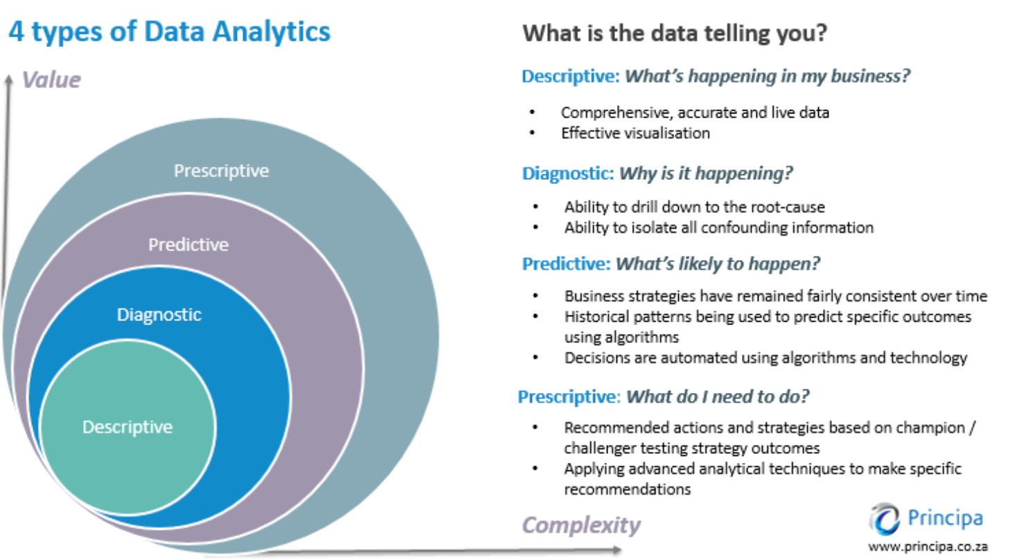
THE ANALYSIS
Descriptive Analytics - What’s Happening? :
Generally, bank customers who are 40-60 years old, have a lower credit score and have a credit card are more prone to leaving the bank.
Diagnostic Analytics – Why is it happening? :
We will need to collect more information and ask further questions. From the data and our decision tree model, we know that customers age is a major contributor in them leaving the bank.
Predictive Analytics – What’s likely to happen? :
Using our Logistic Regression or Decision Tree model, not only can we predict if a customer will exit the bank or not, we can also get the probability of them leaving.
Prescriptive Analytics – What do I do? :
We can use our probability scores of customers exiting to devise strategies of customer retention plans i.e. providing incentives to customers at risk of exiting the bank.

Slide 28
PROBLEM STATEMENT & RECAP
Problem: The bank is losing customers and is interested in gaining insights about why they are leaving and if they can predict who is at risk of leaving so they can offer them incentives to stay. Ultimately, this reduces to a binary classification problem.
Need for Application: We need to prevent customers from leaving the bank.
It is important that rather than just predicting if the bank customer will exit the bank or not, we would rather have an estimate of the probability that the customer will exit the bank or not. We could rank the customers by their probability of leaving, and allocate an incentive budget to the highest probabilities in hopes of retaining them.
Two problems with this approach:
Predicting a customer will leave but does not. This is called a false positive and can be expensive, inconvenient and time consuming for all parties.
No incentive offers provided but the customer leaves. This is called a false negative and we would like to prevent these as it results in lost revenue to the bank. Exactly, what we are trying to prevent!

Slide 29
POTENTIAL SOLUTIONS:
Solution 1:
We can rank the customers by their probability of leaving the bank and set aside a budget to incentivize those customers not to leave the bank.
Flipping this approach around, we can rank the customers by highest expected loss to the bank if they lose their business and reach out to those customers.
Solution 2:
Provide training to the bank staff to improve their customer services. Track and measure their performances using analytics.

Slide 30
QUESTIONS TO ASK GOING FORWARD
Why are more female customers leaving the bank?
Are customers with credit cards moving their business to other banks with better rates?
Why are customers in the 40 years - 60 years age range exiting the bank?
Does the bank have a bigger market in France than Spain and Germany based on their customers?
Is it possible to gather data on metrics like customer satisfaction score that can provide us with more insights?

Slide 31
POTENTIAL ADDITIONS
The best way to improve customer retention is to train the bank staff in customer relation best practices and investing in their skills. Some suggestions that can be explored are:
Empowering employees
Allow consumers to self-service
Stay consistent across all touch points
Educate customers on financial literacy
Embrace financial technology
Become an advisor, not just a lender, for small businesses
Segment your client base and create personalized customer experiences
Keep iterating on processes

Slide 32
LOOKING TO THE FUTURE
This problem was about equipping the bank with actionable knowledge regarding their customers. When modeling the data, we should not use the predictive metric as our final solution. Instead, we should use the information we get from modeling and arm the bank staff so they can carry out informed decision making.
Another thing the bank could do is start collecting more data on more features for e.g. how long the customer has been with the bank, satisfaction score with the bank etc. These things might help us improve our model, especially collecting more data as this bank customer dataset was relatively small. Once we have more data, we can go back and improve our predictions as well as gain further insights to see if anything has changed now that we have more customer information.
After our attempts to understand why customers are leaving the bank, we can flip the problem around and ask ourselves:
What features contribute most to customers retaining their services with the bank?
What features cause employees not to quit?
What is the most valued thing about the bank by the customers?

